Slide 1
Docker, directo a producción
De como “metimos la pata”

Slide 2
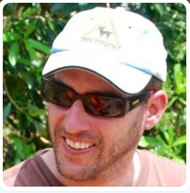

Sergio Navarro Pino
I work as a Software Development Engineer in AnalyticAlways
Sometimes I write some tweets @snavarropino
I also have a blog…
http://www.serginet.com

Slide 3
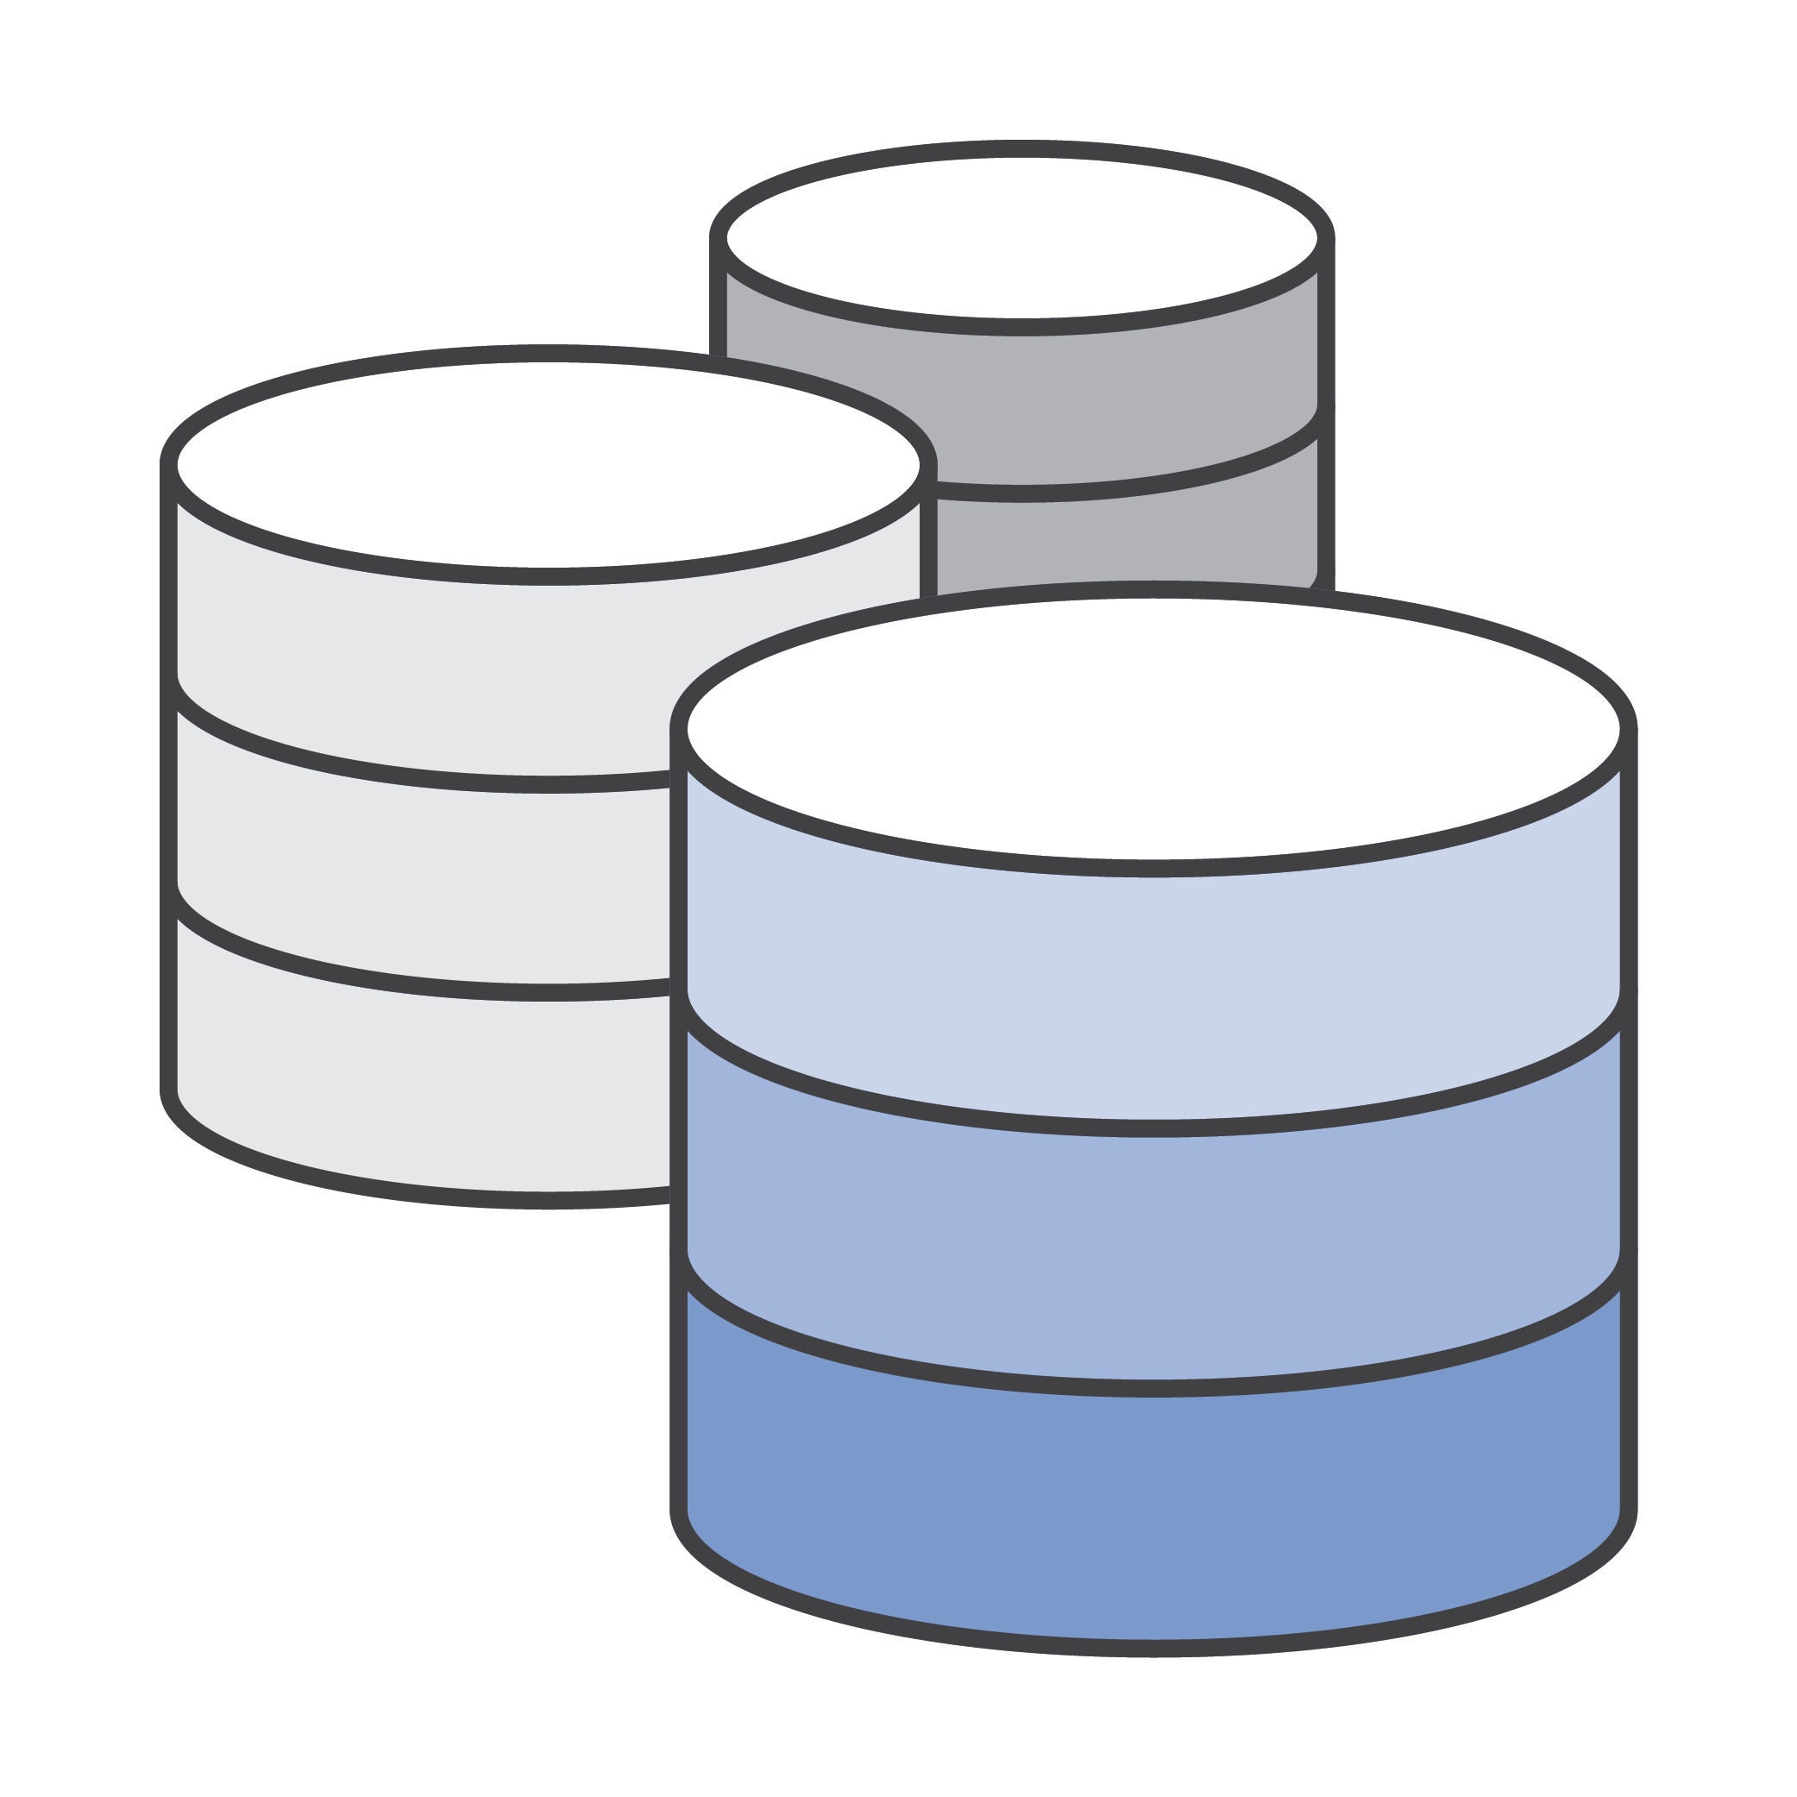

MY “bonito monolito”
Shop
Backend
Control panel
Services
Cmdlets
Business Logic (multiple dll)
Data Acess

Slide 4


How did we use to deploy?
Several TFS 2013 Chained builds that
Build Unit tests (few)
Publish an artifact for each front
Shop
Control Panel
Backend
Services
CmdLets
Publish an artifact for each plugin
An Octopus Deployment process that
Performs infraestructura tasks:
Firewall
Software dependencies (IIS, .NET)
Certificates
Initialize/Update Database
Deploys each front
Executes aceptance testing (very few)

Slide 5

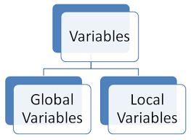
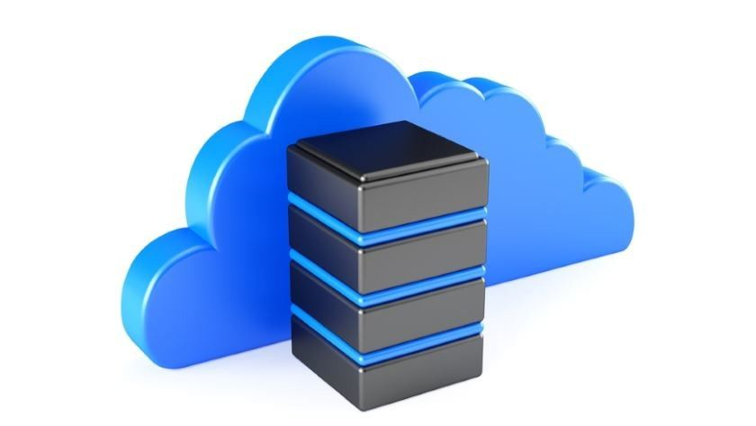
How did we use to deploy?

Slide 6

About 10 countries in single tenant mode
3 countries in a multitenant platform
For each country, several environents:
Dev
Qa
Pre (High availability)
Pro (High availability)
Deployment in dev machines quite complicated
Environment related bugs due to deployment / configuration issues
Bugs and poor customer confidence
More than 50 servers
Lack of Agility for deployments / upgrades
24 hours to deploy/upgrade
a DEV/QA env
48 hours to deploy/upgrade
a PRE/PRO env

Slide 7




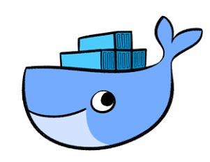

Slide 8

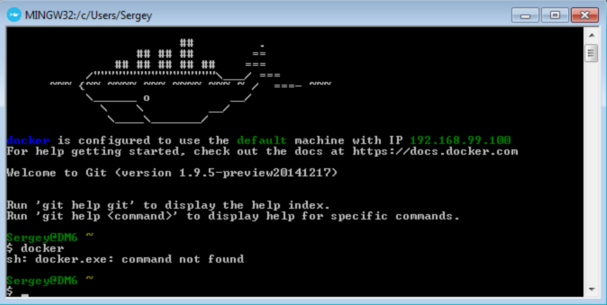
First atTempt: artifacts to image
Docker Image
Octopus Server
Calamari (Optopus agent)
Octopacks
Software dependencies (IIS, .NET)

Slide 9



First atTempt: did we improve?
Bugs and poor customer confidence
More than 50 servers
Lack of Agility for deployments / upgrades
New problems:
Now we required a connection to Optopus Server when we launch a container

Slide 10

SECOND atTempt: offline calamari
Docker Image
Chopito (Modified Optopus agent)
Octopacks
Software dependencies (IIS, .NET)
Variables (json)
Deployment process (Powershell)
“The chopito”
https://github.com/NEC-CCBU/NCBSInstall

Slide 11
SecoNd aTtempt: did we improve?
Bugs and poor customer confidence
More than 50 servers
Lack of Agility for deployments / upgrades
Require a direct conection to Octopus when
We launch a container
New/old problem:
About 20 minutes to start a container. We are deploying on Docker run…

Slide 12
third aTtempt: deploy on build
Docker Image
Software dependencies (IIS, .NET)
Variables (json)
Executables

Slide 13
THIRD aTtempt: did we improve?
Bugs and poor customer confidence
More than 50 servers
Lack of Agility for deployments / upgrades
Require a direct conection to Octopus when
We launch a container
About 20 minutes to start a container
New/old problem:
What about configuration?

Slide 14

fourth aTtempt: configuration
Configuration was “attached to image” in json files so we had to create different images for different environments.
This bring us several issues:
Up to 4 images per environment (DEV/QA/PRE/PRO) and version
Images can be different (not only in configuration) between environments
Is this afordable?

Slide 15

If we build several time same bits result always in the same image?

Slide 16
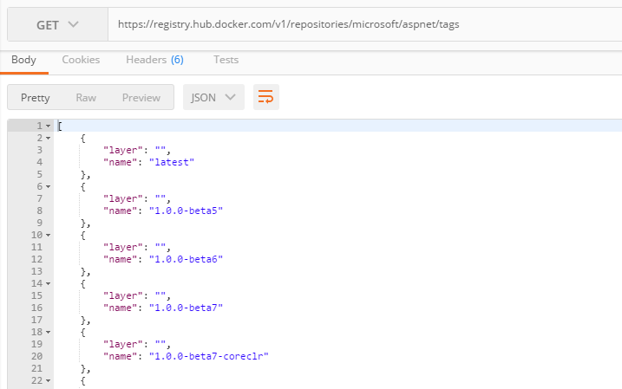
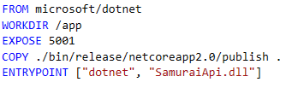
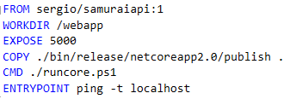

tags
If you don’t set an specific tag, you are using “latests”
If you set an specific tag, it can be rewriten

Slide 17



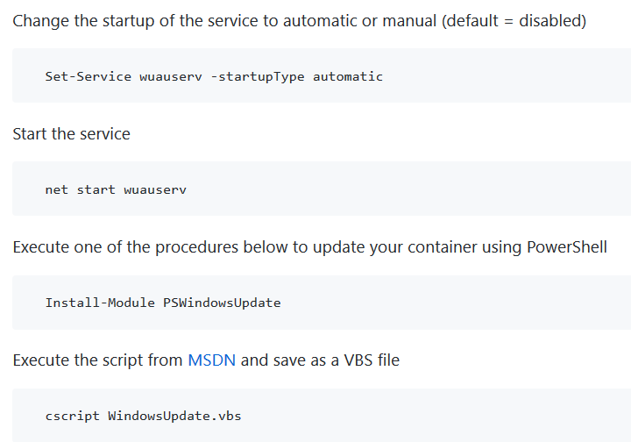
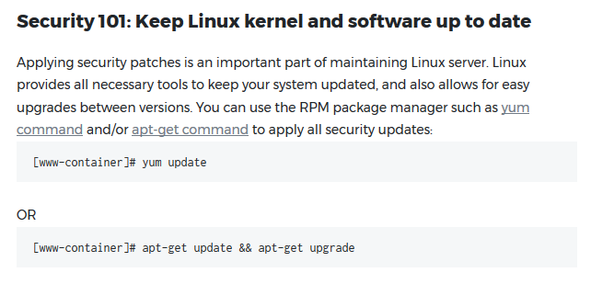
KEEPing you container updated
Let’s update OS running in our containers!

Slide 18
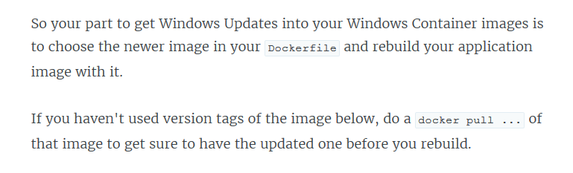
KEEPing you container updated
Let’s update OS running in our containers!
https://stefanscherer.github.io/keep-your-windows-containers-up-to-date

Slide 19

fourth aTtempt: configuration
So we want just one image that can be configured properly for each environment:
web.config
Set in web.config by build (transformation)
Docker build/run
Environment variables / file
Set in dockerfile / scripts
per environment
general

Slide 20
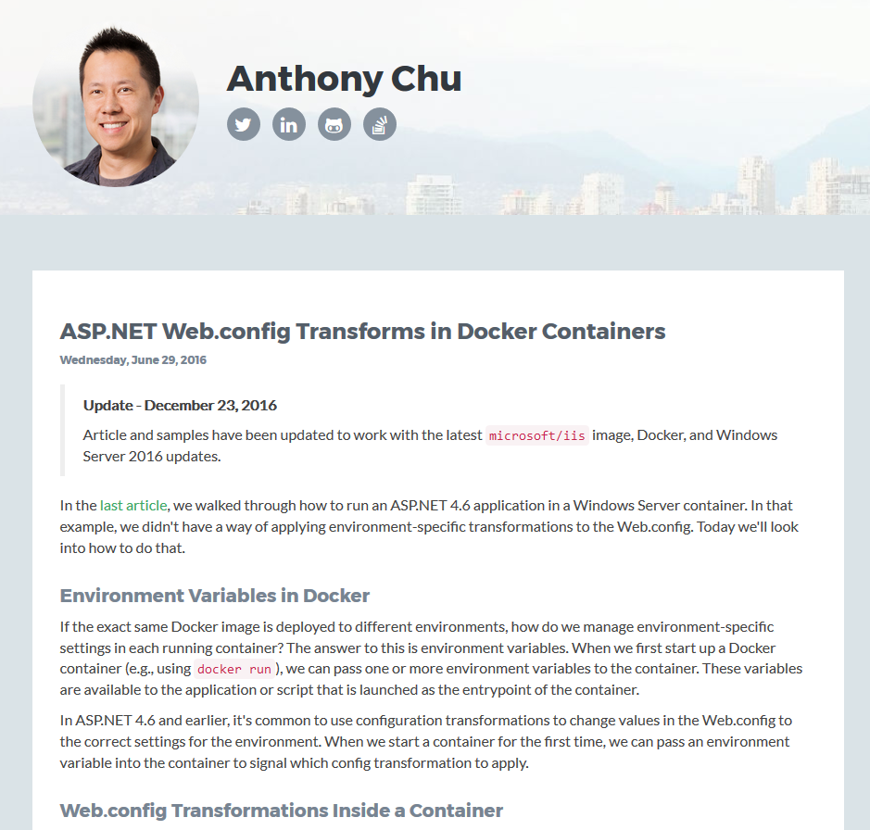
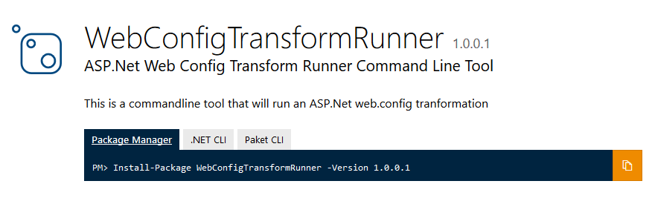
fourth aTtempt: configuration
In .net core we have out of the box supprt for environemnt variables
In .net, how to modify web.config for each environment?
a) Using modified Octopus Calamari, AKA “Chopito” when container starts
b) Using nuget WebConfigTransformRunner to transform web.config
https://anthonychu.ca/post/aspnet-web-config-transforms-docker-containers/

Slide 21



CI/CD pipeline
Build
Deploy to QA
Acceptance tests
Deploy to PRE
Pull “latest”
Push “latest”
Pull “latest”
Registry

Slide 22
CI/CD pipeline
Build
Deploy to QA
Acceptance tests
Label latest
Deploy to PRE
Pull “vX”
Push “latest”
Push vX
Pull “latest”
Registry

Slide 23

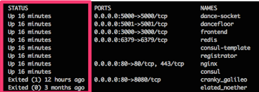
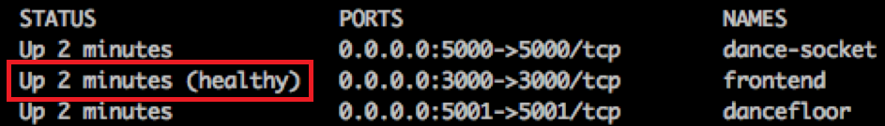
HEALTHcheck

Slide 25

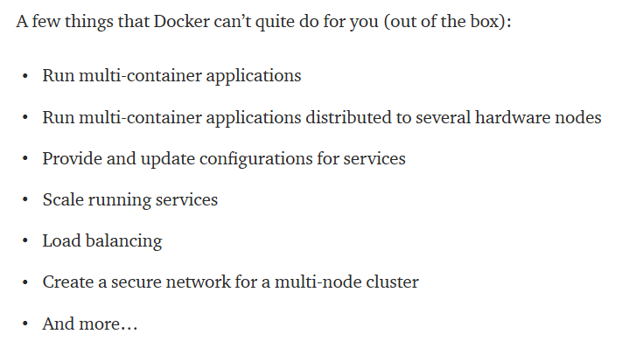
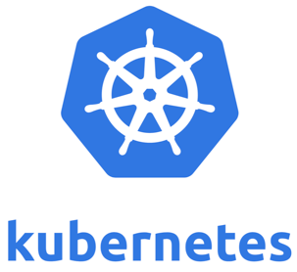
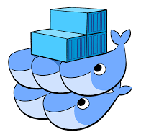
What about orchestators?

Slide 26
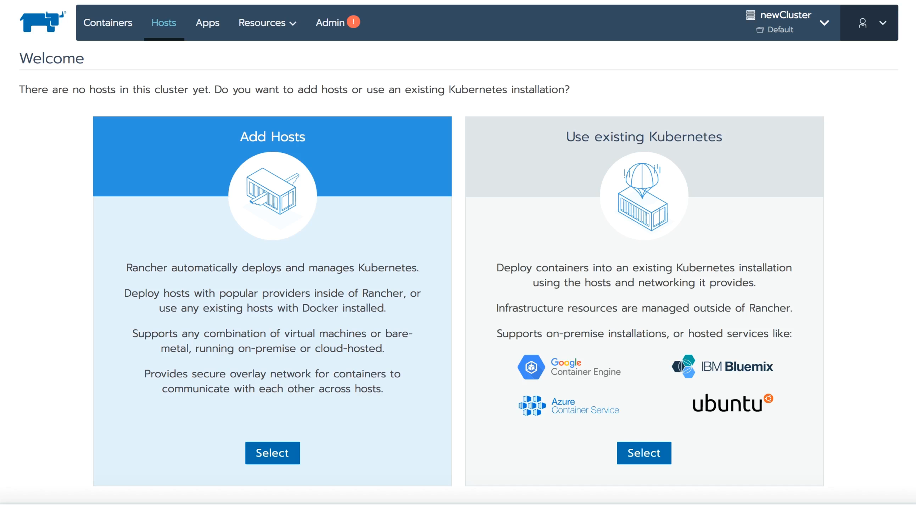

Some help with management?
https://rancher.com/

Slide 27

"Yo... he visto cosas que vosotros no creeríais: Atacar naves en llamas más allá de Orión.
He visto rayos C brillar en la oscuridad cerca de la Puerta de Tannhäuser.
Todos esos momentos se perderán... en el tiempo... como lágrimas en la lluvia. Es hora de morir"
- Roy Batty

